Slide 1
Sequential Logic
Chapter 5a
Imran Siddiqi
imran.siddiqi@mcs.edu.pk
Computer Science Department
College of Telecommunication Engineering
National University of Sciences and Technology

Slide 2
Combinational Circuit
So far we’ve just worked with combinational circuits, where applying the same inputs always produces the same outputs.
This corresponds to a mathematical function, where every input has a single, unique output.
No way of remembering or storing information after inputs have been removed.
Combinational
circuit
Inputs
Outputs

Slide 3
Sequential Circuit
The outputs of a sequential circuit depend on not only the inputs, but also the state, or the current contents of some memory.
This makes things more difficult to understand, since the same inputs can yield different outputs, depending on what’s stored in memory.
The memory contents can also change as the circuit runs.
Inputs
Combinational
circuit
Outputs
Memory

Slide 4
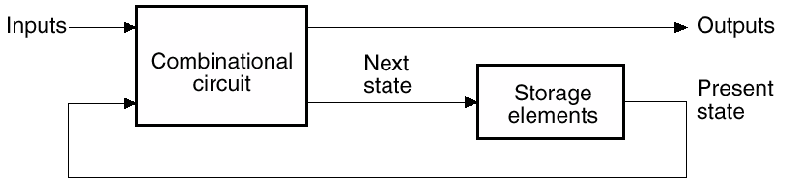
Sequential Circuit
Many real-life devices are sequential in nature:
  Combination locks open if you enter numbers in the right order.
  Elevators move up or down and open or close depending on the buttons that are pressed on different floors and in the elevator itself.

Slide 5
Types of Sequential Circuits
Synchronous
  State changes synchronized by one or more clocks
Asynchronous
  Timing of changes are independent of any clocks

Slide 6
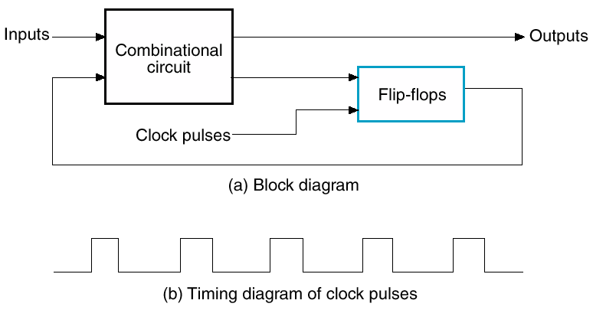
Synchronous Sequential Circuits
Changes enabled by clock

Slide 7
Storage Elements
Latch
Flip-Flop – a latch that transitions on a clock
Registers

Slide 8
Memory
A memory should have at least three properties.
  1. It should be able to hold a value.
  2. You should be able to read the value that was saved.
  3. You should be able to change the value that’s saved.
We’ll start with the simplest case, a one-bit memory.
  1. It should be able to hold a single bit, 0 or 1.
  2. You should be able to read the bit that was saved.
  3. You should be able to change the value. Since there’s only a single bit, there are only two choices:
    Set the bit to 1
    Reset, or clear, the bit to 0.

Slide 9
Basic Idea of Storage
How can a circuit “remember” anything, when it’s just a bunch of gates that produce outputs according to the inputs?
The basic idea is to make a loop, so the circuit outputs are also inputs.
First Attempt – Cross Coupled Inverter

Slide 10
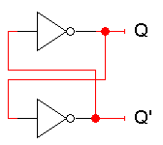
Cross Coupled Inverter

Slide 11
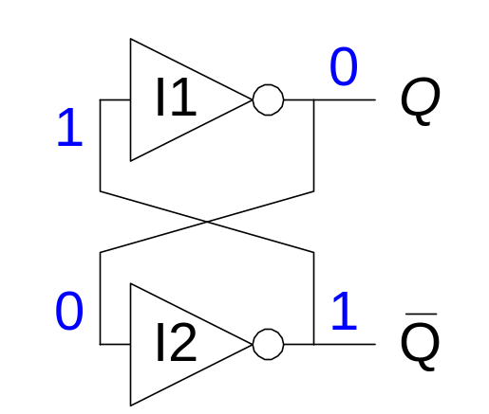
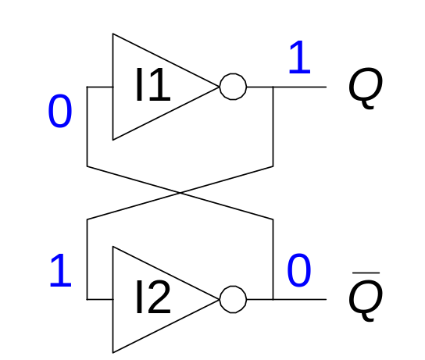
Cross Coupled Inverter
Consider 2 possible cases:
  Q = 0: then Q’ = 1 and Q = 0 (consistent)
  Q = 1: then Q’ = 0 and Q = 1 (consistent)

Slide 12
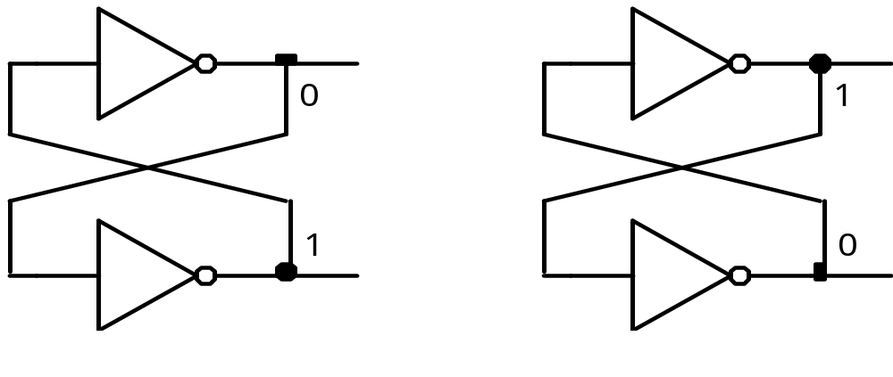
Cross Coupled Inverter
Does this satisfy the properties of memory?
  These circuits “remember” Q, because its value never changes. (Similarly, Q’ never changes either.)
  We can also “read” Q, by attaching a probe or another circuit.
  But we can’t change Q! There are no external inputs here, so we can’t control whether Q=1 or Q=0.
State 0
State 1

Slide 13
SR (set-reset) Latches
Replace the Inverters with NOR gates
Add two inputs – R & S
R
Q
Q’
S

Slide 14
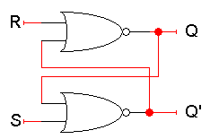
SR (set-reset) Latches
Here Q and Q’ feed back into the circuit. They’re not only outputs, they’re also inputs!
To figure out how Q and Q’ change, we have to look at not only the inputs S and R, but also the current values of Q and Q’:
Q_{next} = (R + Q’_{current})’
Q’_{next} = (S + Q_{current})’

Slide 15
SR (set-reset) Latches
SR = 00
What if S = 0 and R = 0?
The equations reduce to:
Q_{next} = (0 + Q’_{current})’ = Q_{current}
Q’_{next} = (0 + Q_{current})’ = Q’_{current}
So when SR = 00, then Q_{next} = Q_{current}. Whatever value Q has, it keeps.
This is exactly what we need to store values in the latch.
Q_{next} = (R + Q’_{current})’
Q’_{next} = (S + Q_{current})’

Slide 16
SR (set-reset) Latches
SR = 10
What if S = 1 and R = 0?
Since S = 1, Q’_{next} is 0, regardless of Q_{current}:
Q’_{next} = (1 + Q_{current})’ = 0
Then, this new value of Q’ goes into the top NOR gate, along with R = 0.
Q_{next} = (0 + 0)’ = 1
So when SR = 10, then Q’_{next} = 0 and Q_{next} = 1.
This is how you set the latch to 1. The S input stands for “set.”
Q_{next} = (R + Q’_{current})’
Q’_{next} = (S + Q_{current})’

Slide 17
SR (set-reset) Latches
SR = 10
  0. Suppose that initially, Q = 0 and Q’ = 1.
  1. Since S=1, Q’ will change from 1 to 0 after one NOR-gate delay (marked by
  vertical lines in the diagram for clarity).
  2. This change in Q’, along with R=0, causes Q to become 1 after another gate delay.
  3. The latch then stabilizes until S or R
  change again.
Q_{next} = (R + Q’_{current})’
Q’_{next} = (S + Q_{current})’
0 1 2 3 4
S
R
Q
Q’

Slide 18
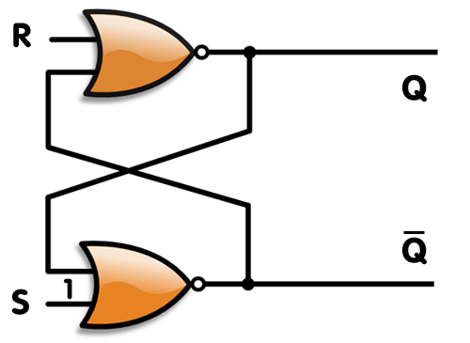
SR (set-reset) Latches

Slide 19
SR (set-reset) Latches
SR = 01
What if S = 0 and R = 1?
Since R = 1, Q_{next} is 0, regardless of Q_{current}:
Q_{next} = (1 + Q’_{current})’ = 0
Then, this new value of Q goes into the bottom NOR gate, where S = 0.
Q’_{next} = (0 + 0)’ = 1
So when SR = 01, then Q_{next} = 0 and Q’_{next} = 1.
This is how you reset, or clear, the latch to 0. The R input stands for “reset.”
Again, it can take two gate delays before a change in R propagates to the output Q’_{next}.
Q_{next} = (R + Q’_{current})’
Q’_{next} = (S + Q_{current})’

Slide 20
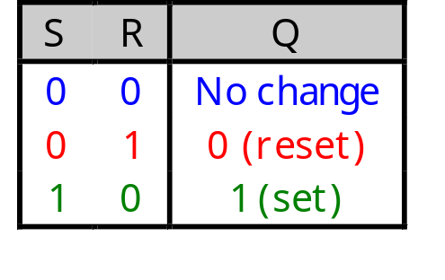
SR Latches are Memories
This little table shows that our latch provides everything we need in a memory: we can set it, reset it, and remember the current value.
The output Q represents the data stored in the latch. It is sometimes called the state of the latch.

Slide 21
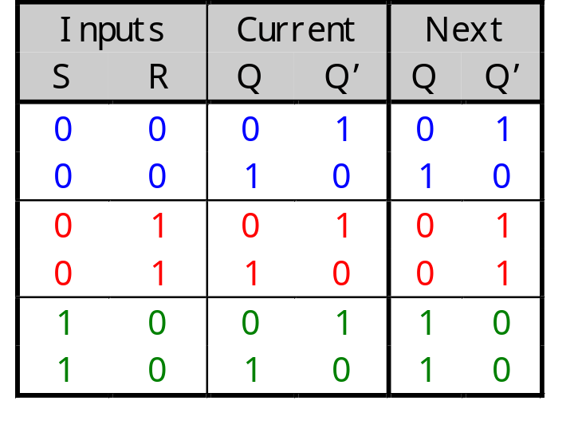
SR Latches are Memories
We can expand the table above into a state table, which explicitly shows that the next values of Q and Q’ depend on their current values, as well as on the inputs S and R.

Slide 22
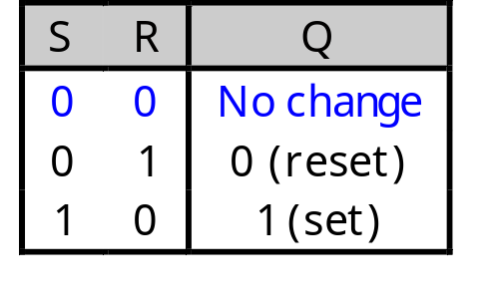
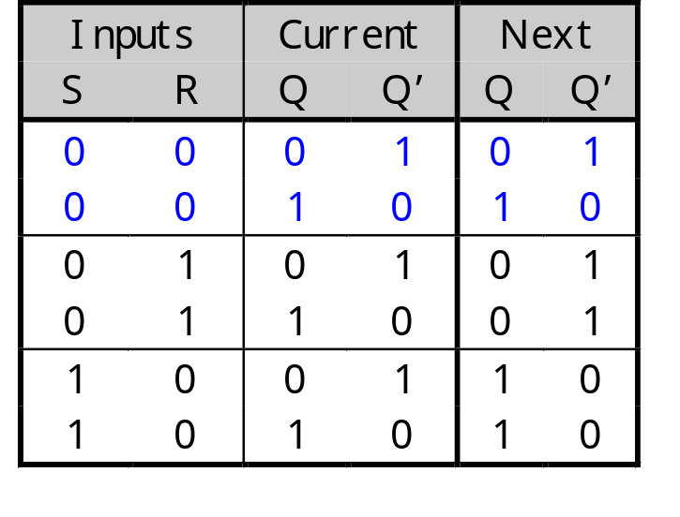
SR Latches are Sequential
Notice that for inputs SR = 00, the next value of Q could be either 0 or 1, depending on the current value of Q.
So the same inputs can yield different outputs, depending on whether the latch was previously set or reset.
This is very different from the combinational circuits that we’ve seen so far, where the same inputs always yield the same outputs.

Slide 23
What about SR = 11
Both Q_{next} and Q’_{next} will become 0.
This contradicts the assumption that Q and Q’ are always complements.
Another problem is what happens if we then make S = 0 and R = 0 together.
Q_{next} = (0 + 0)’ = 1
Q’_{next} = (0 + 0)’ = 1
But these new values go back into the NOR gates, and in the next step we get:
Q_{next} = (0 + 1)’ = 0
Q’_{next} = (0 + 1)’ = 0
The circuit enters an infinite loop, where Q and Q’ cycle between 0 and 1 forever.
Q_{next} = (R + Q’_{current})’
Q’_{next} = (S + Q_{current})’
0
0
0
0
0
1
0
1

Slide 24
What about SR = 11
Q_{next} = (R + Q’_{current})’
Q’_{next} = (S + Q_{current})’
Circuit ossiclates between 00 and 11 under the assumption that both NOR gates have exaclty the same delay.
Practically this would not be true so the state would be either 01 or 10.
Since we cannot predict it, so the latch is said to be in undefined state for input 11.
0
0
0
0
0
1
0
1

Slide 25
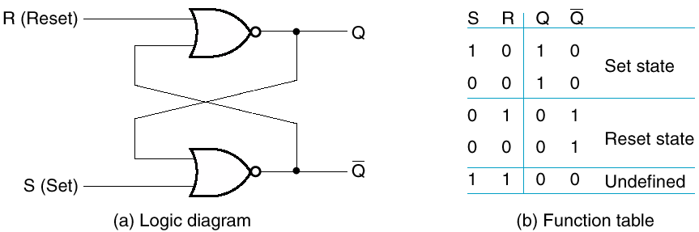
SR Latches

Slide 26
S’R’ Latch
Similar – made from NANDs
S
Q
Q’
R

Slide 27
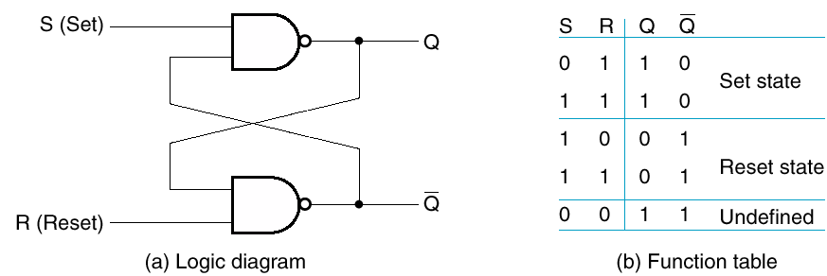
S’R’ Latch
This is just like an SR latch, but with inverted inputs, as you can see from the table.
You can derive this table by writing equations for the outputs in terms of the inputs and the current state, just as we did for the SR latch.

Slide 28
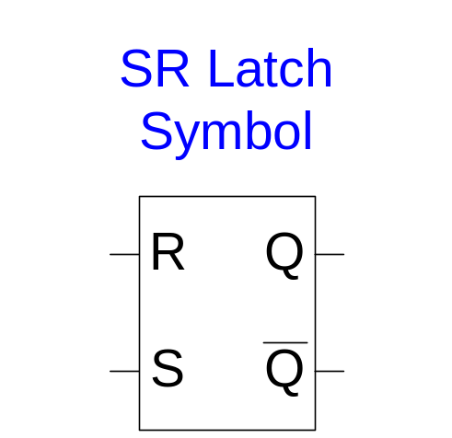
SR Latch Summary
SR stands for Set/Reset Latch
  Stores one bit of state (Q)
Control what value is being stored with S, R inputs
  Set: Make the output 1 (S = 1, R = 0, Q = 1)
  Reset: Make the output 0 (S = 0, R = 1, Q = 0)
Behavior undefined/invalid when:
  S = R = 1

Slide 29
References
Chapter 6 – Digital Design Morris Mano
Digital Logic and Computer Design – M. Singh, University of North Carolina
Latches & Flip-flops - Bobby Nazief
Material in these slides has been taken from, the following resources

